Slide 1
DELE PART A
By: Kent & Yu Jie

Slide 2
Overview
Steps Taken:
Exploratory Data Analysis
Data Wrangling
Data Preprocessing
Building Models
Further Improvements

Slide 3
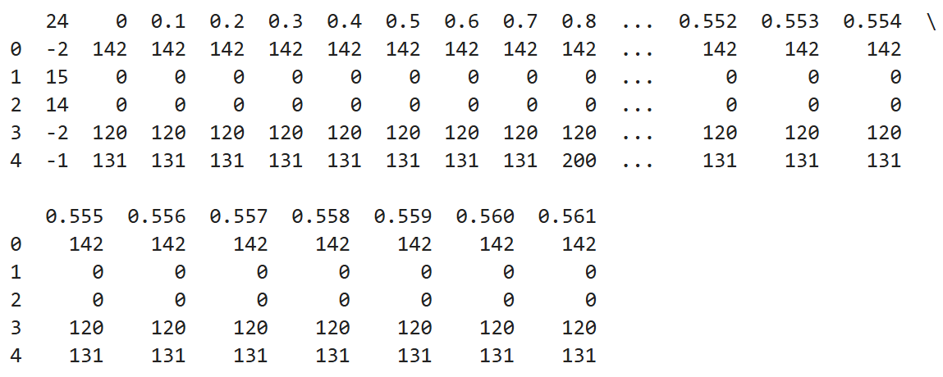
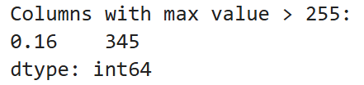
1) Exploratory Data Analysis
1. Basic commands:
df.shape, df.head()
2. Dropped ‘24’ and continue EDA
3. Find pixel value range of the remaining columns
Observations:
Column 24? → does this have to do with their labels?
Observations:
Suspicious, pixel usually range from 0 to 255, further investigate entries above 255
Observations:
Our task is to generate 28x28 images.
28 X 28 = 784.
Maybe ‘24’ is the column that includes the labels?

Slide 4
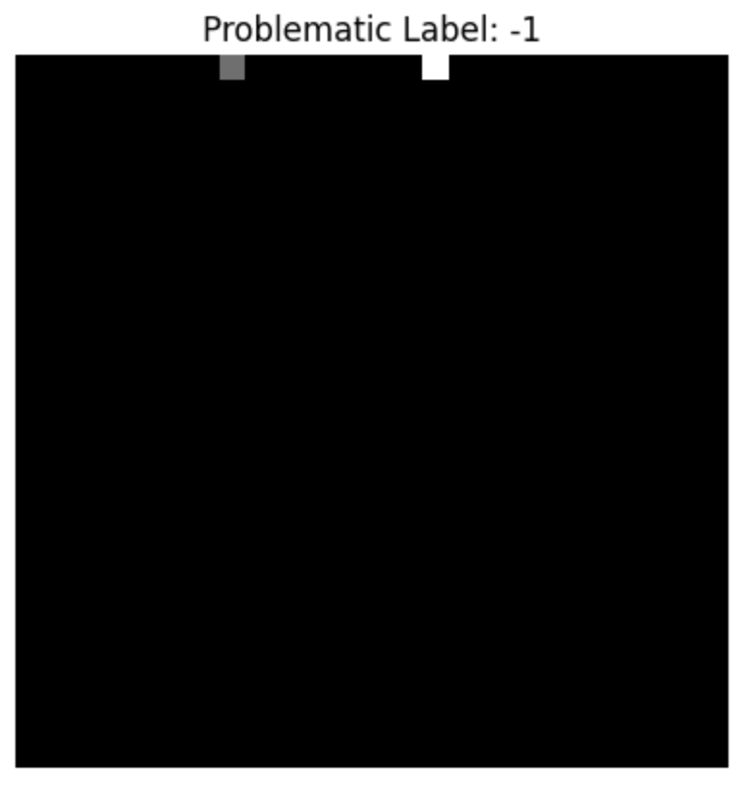
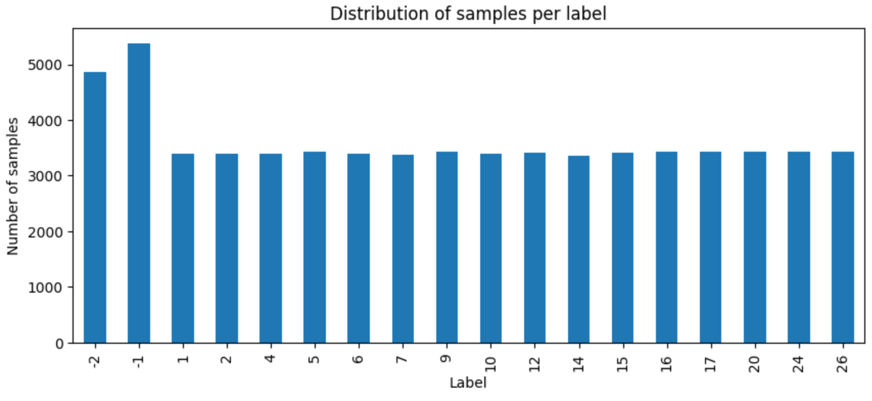
1) Exploratory Data Analysis
Print out the row as an image
4. Print count of ‘24’ (labels)
Observations:
We have 18 labels, our task says we only need 16.
Concluded that 1-26 would be the number of order of the alphabet.
Further analyse -2 and -1
Conclusion:
Row not useful, drop row

Slide 5
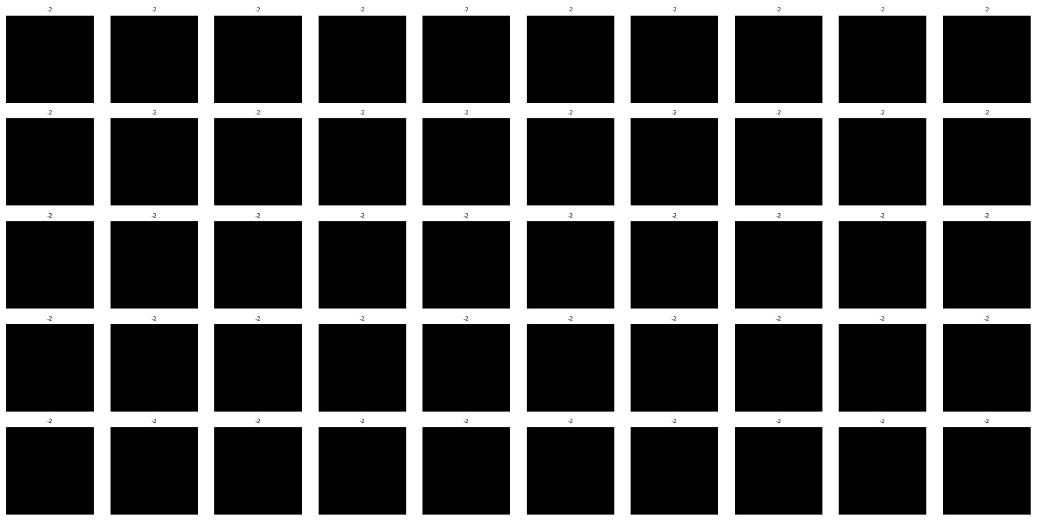
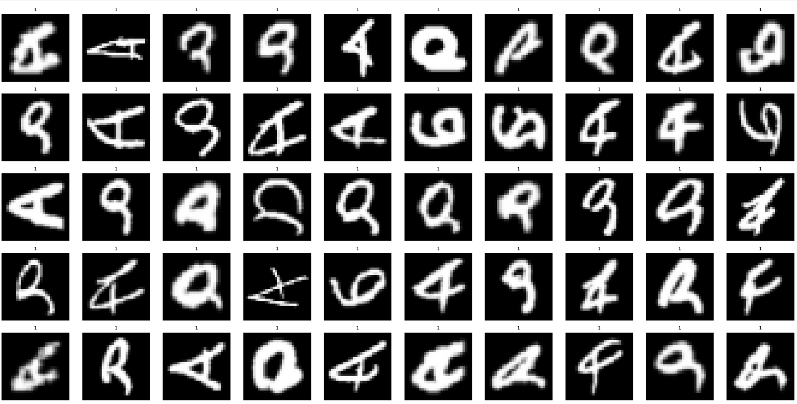
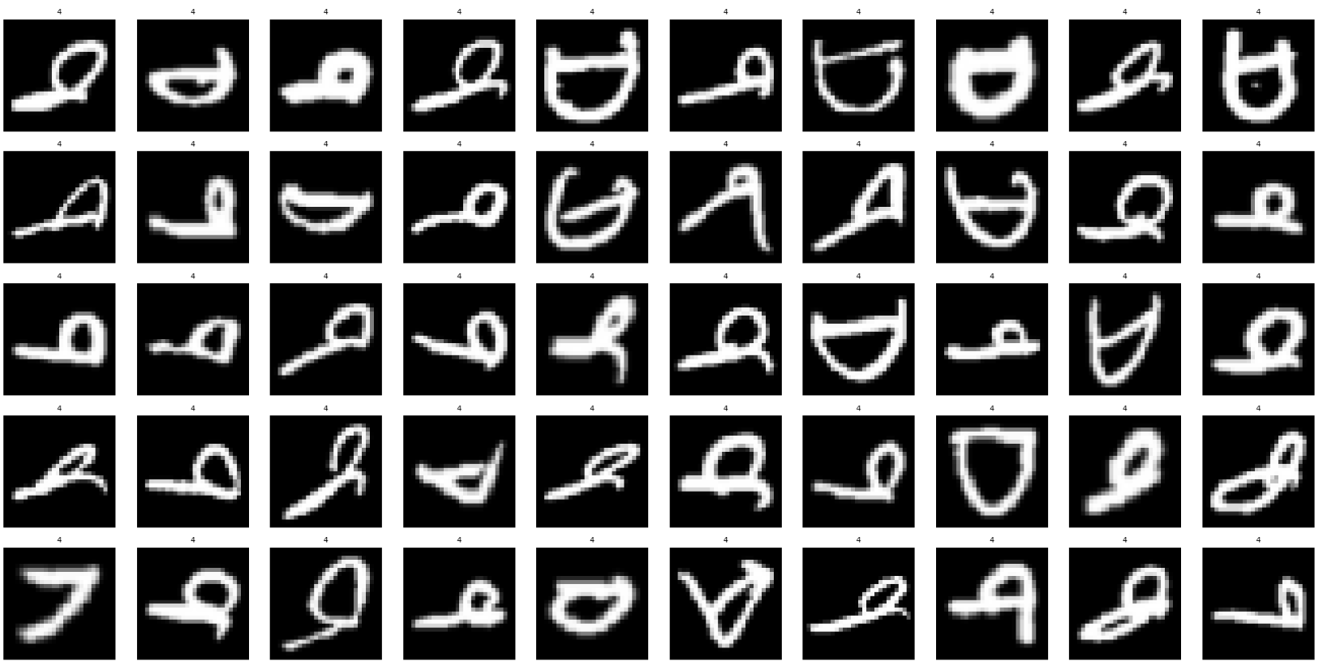
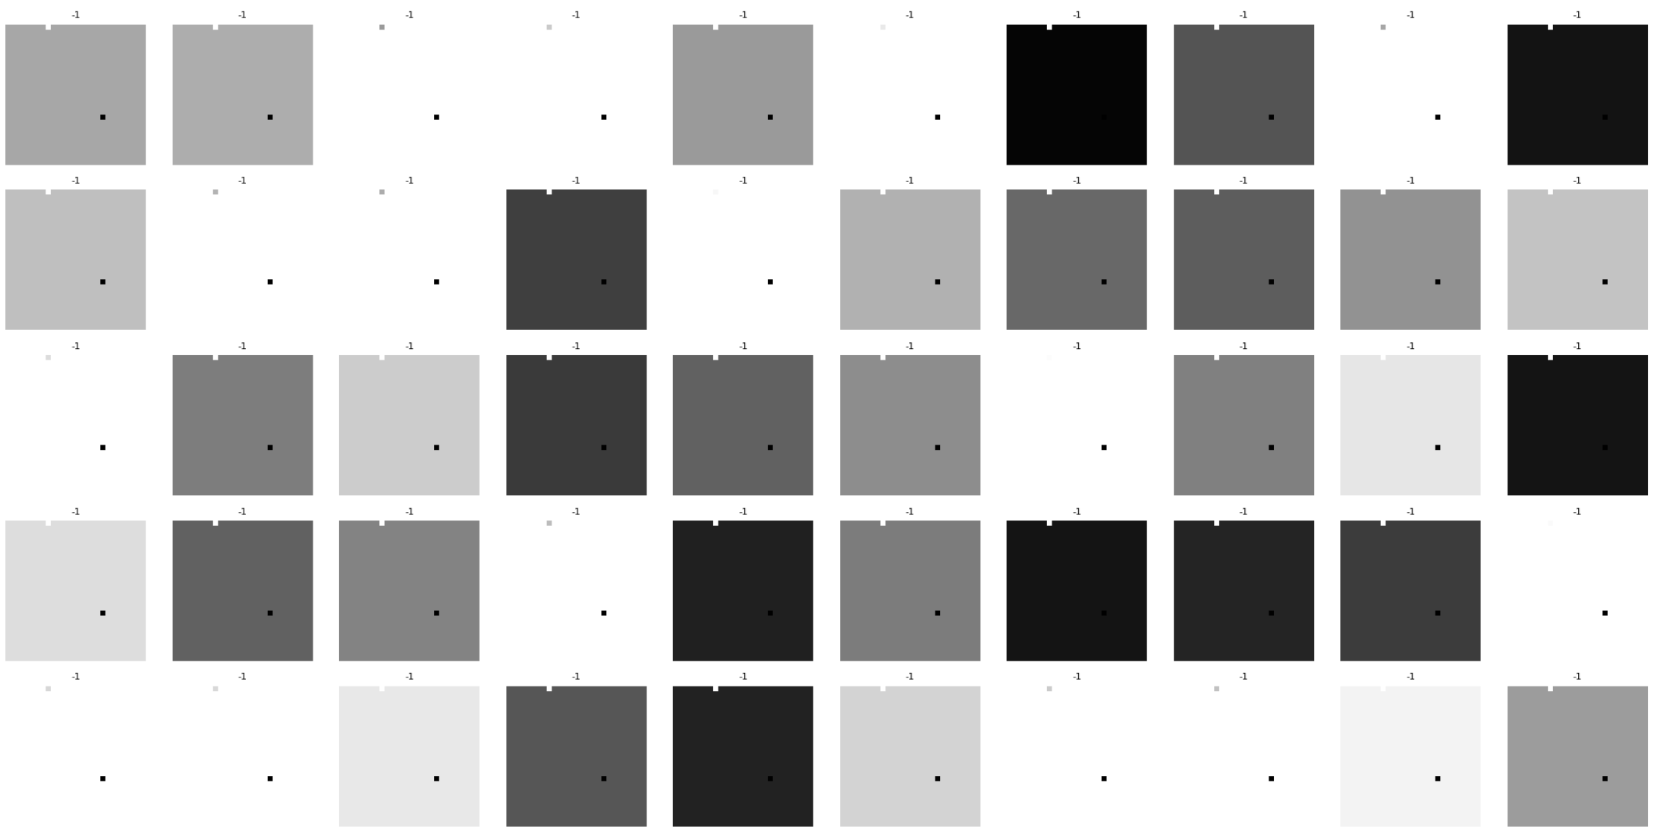
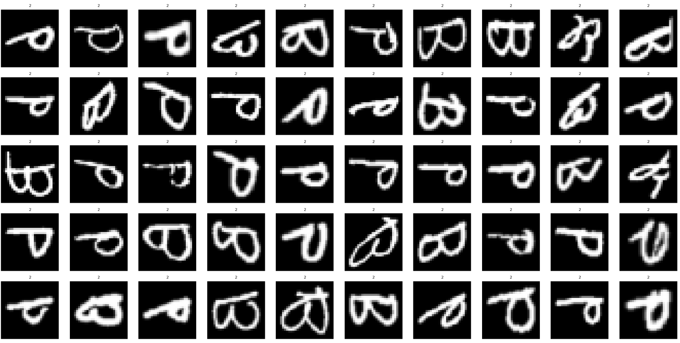
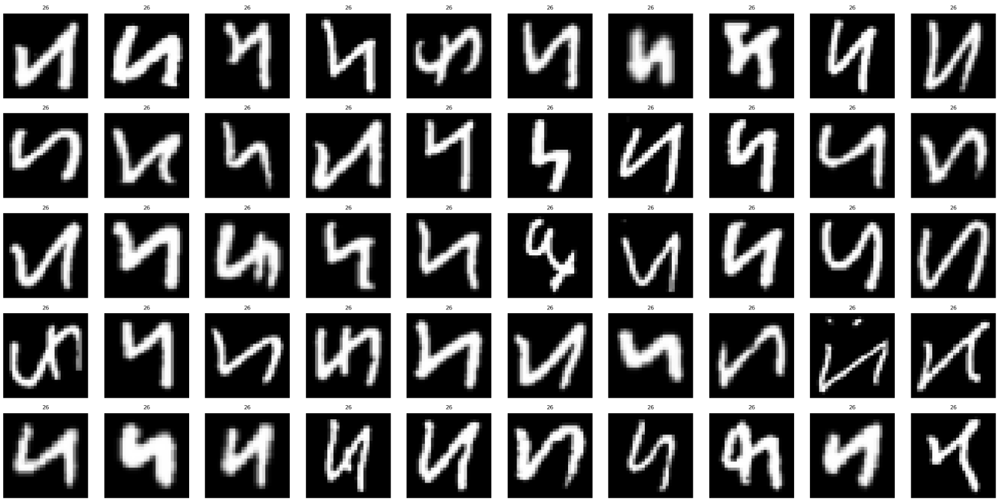
1) Exploratory Data Analysis
Images of -2:
Observations:
Labels -1 and -2 and just blank images with no real use. Essentially noise.
Remove them
5. Analyse other labels
Images of -1:

Slide 6
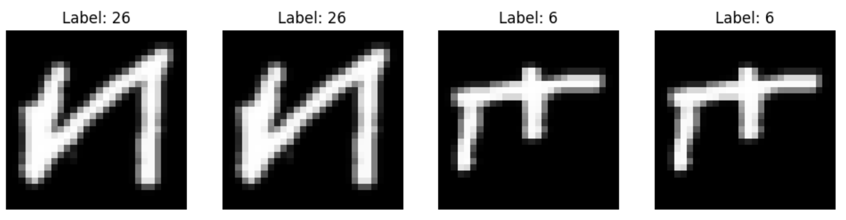
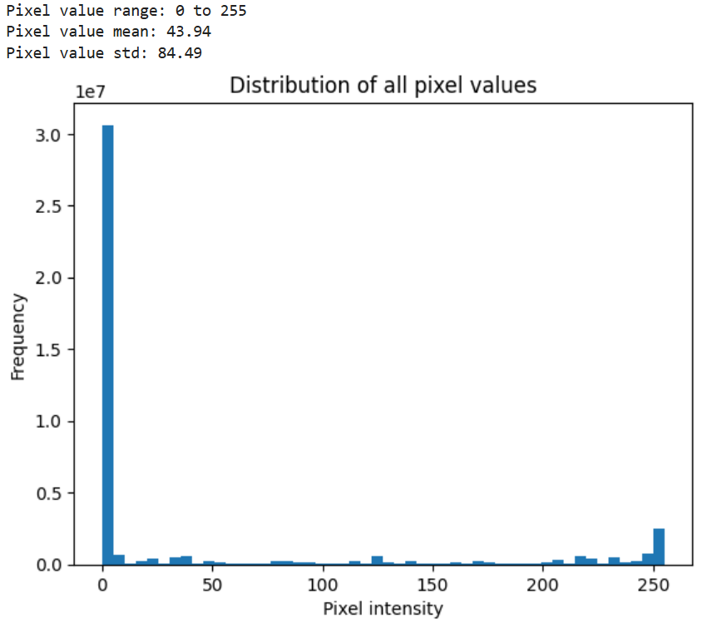
1) Exploratory Data Analysis
Observations of letters:
We can see that the letters are in the wrong orientation.
After examining each class and figuring out fixes for them, we realised that we can apply the same fix for all the classes → rotate 90 clockwise then flip image horizontally.
7. Check for duplicates
6. Analyse pixel values (again)
Observations:
Duplicates found, drop them
Observations:
All pixel values fall under 0-255.

Slide 7
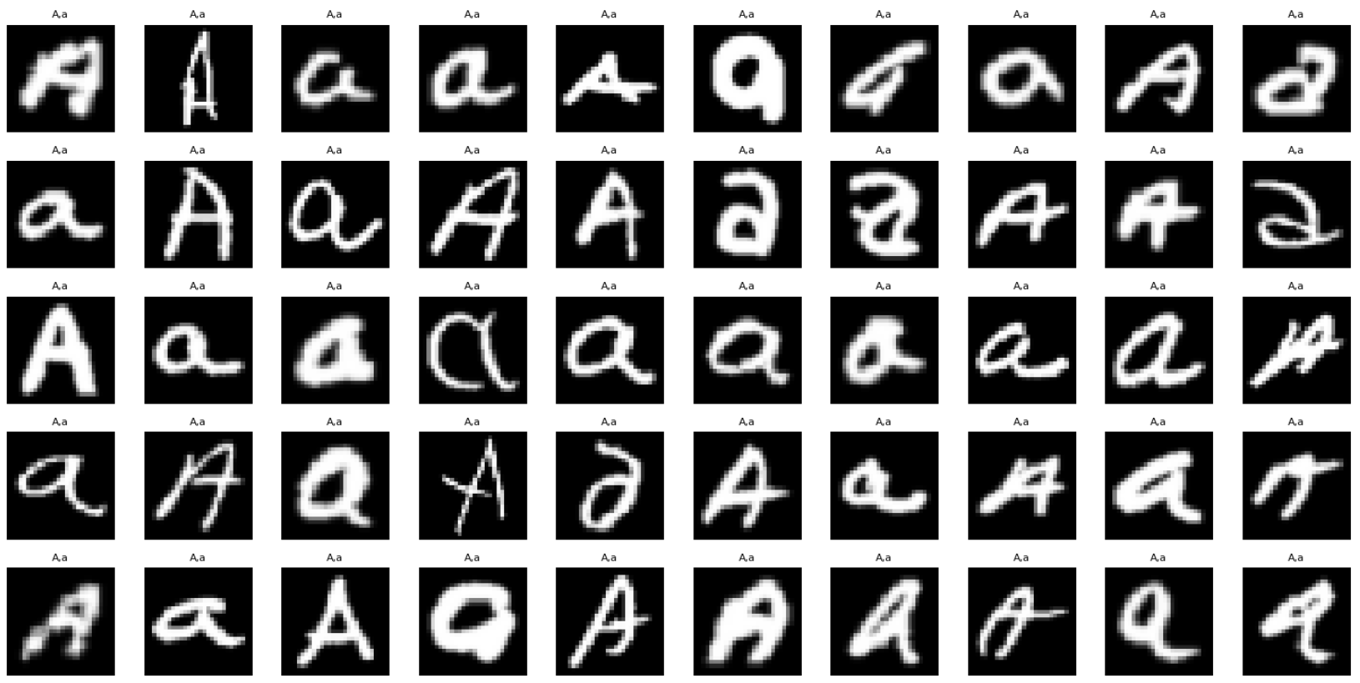
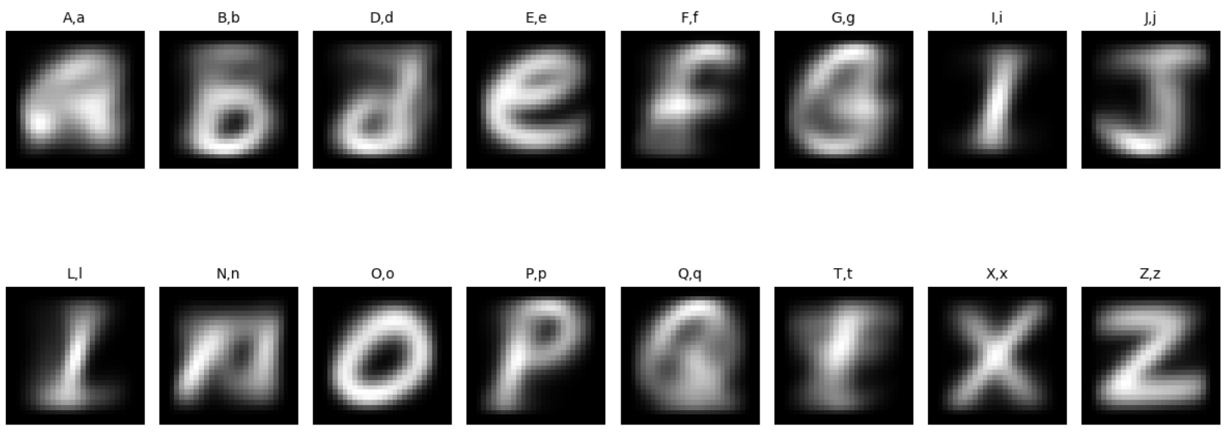
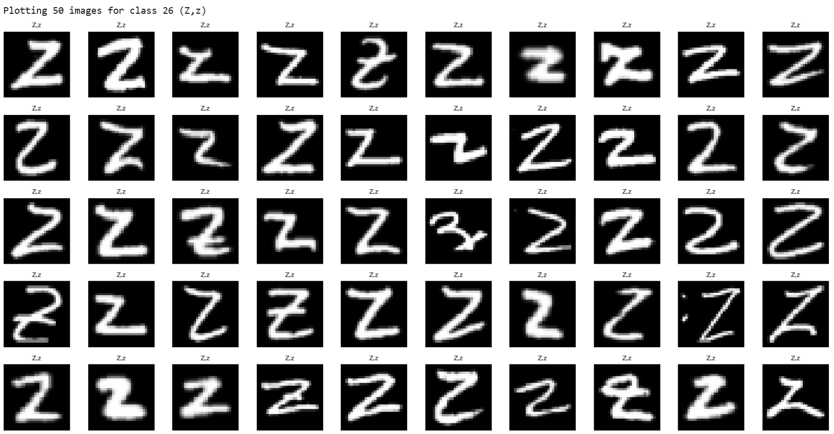
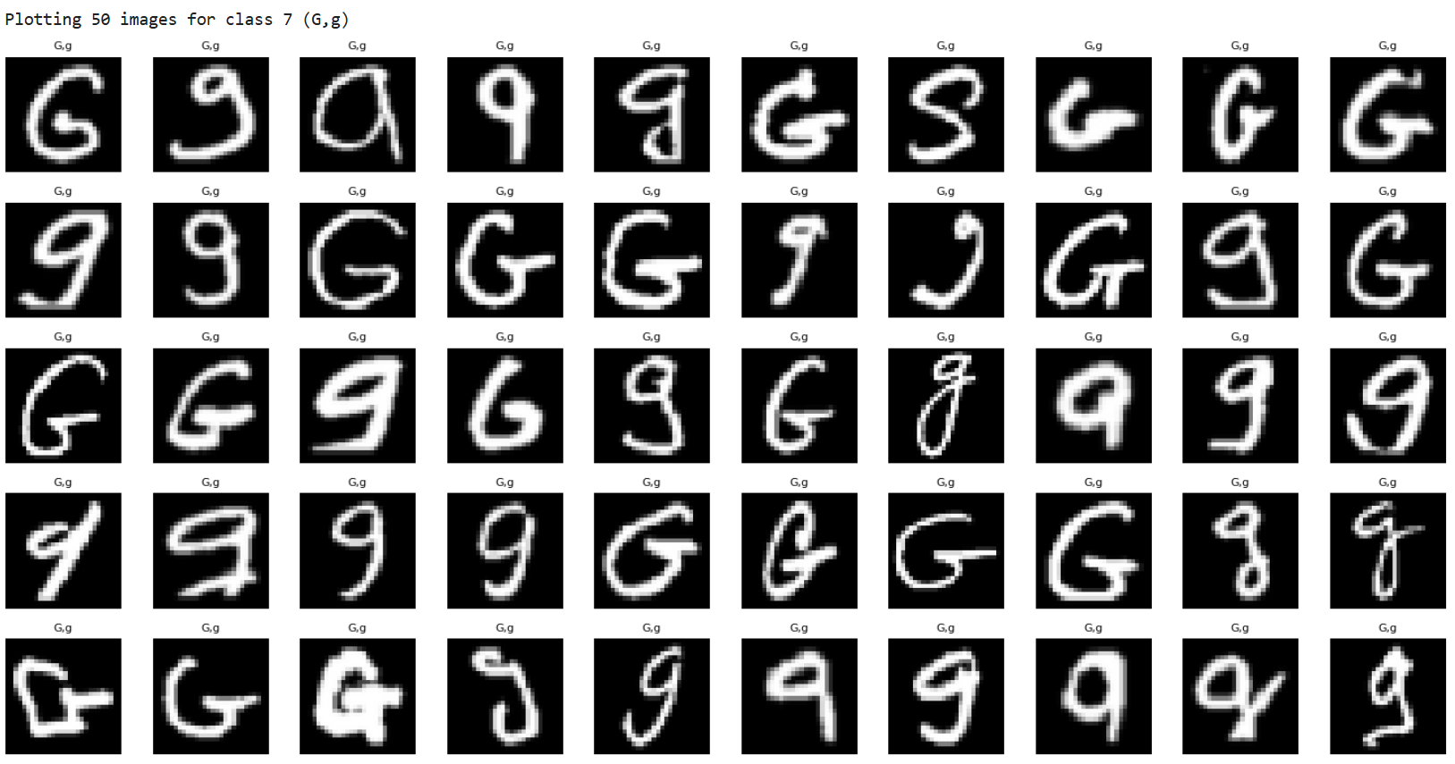
2) Data Wrangling
1. Reset index
2. Rotate and Flip
Observations:
We can see that some letters labelled as g looks really similar to q.
This simply reflects the nature of the data and is not an error.
3. Average image (further analysis)
Observations:
O, o have clear features
But A, a and G, g have blurry and less distinct images → due to the significant difference between the uppercase and lowercase forms of the letters.

Slide 8
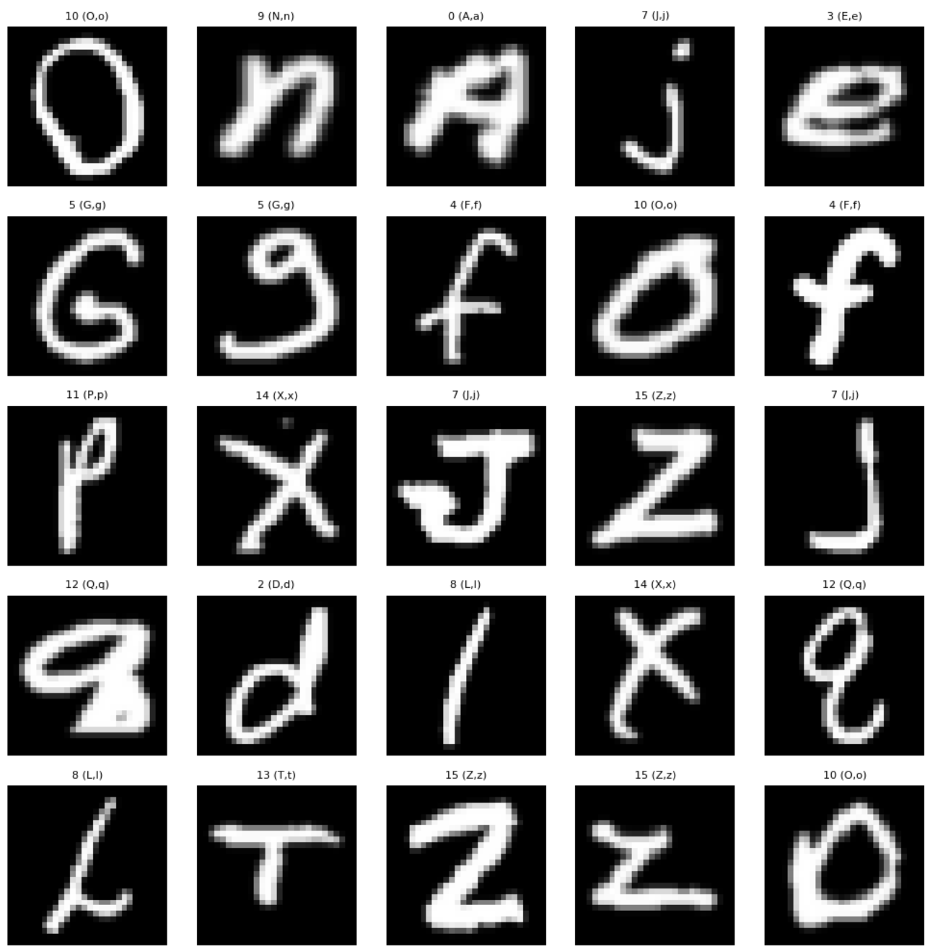
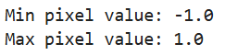
3) Data Preprocessing
1. Normalize pixel values
Why?
If pixel values are between 0 and 255, gradients during training can become unstable.
Need to match our activation function -1 to 1 Tanh.
2. Remapping labels
Needed for cGAN later.

Slide 9
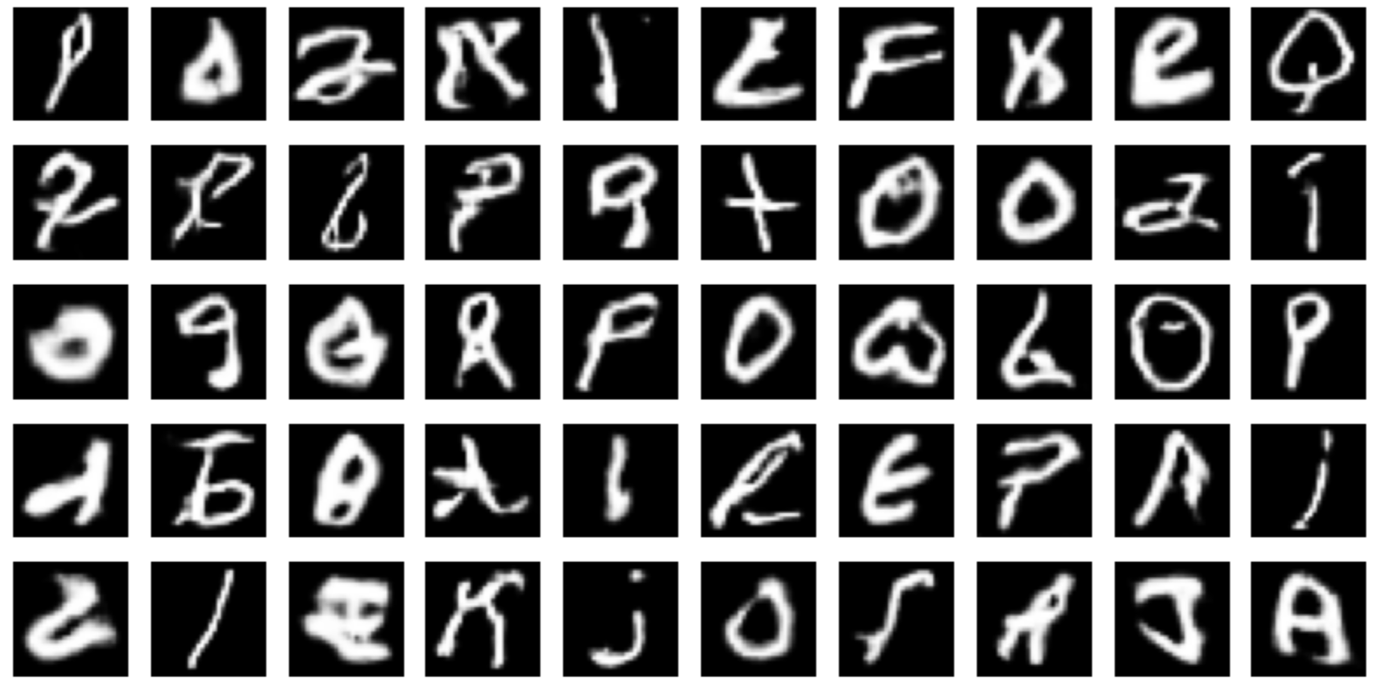
4) Building Model
GAN models we will try:
DCGAN
cGAN
WGAN
How to evaluate?
Eye Score → pick a sample of 50 images and give them a score by classing the images into “Passable” and “Nonsense”.
50 images of DCGAN:
1. DCGAN
Generator: takes random noise an input and learns to generate fake images.
Discriminator: tries to distinguish between real and fake images.
Over time, the generator improves its ability to produce realistic images.

Slide 10
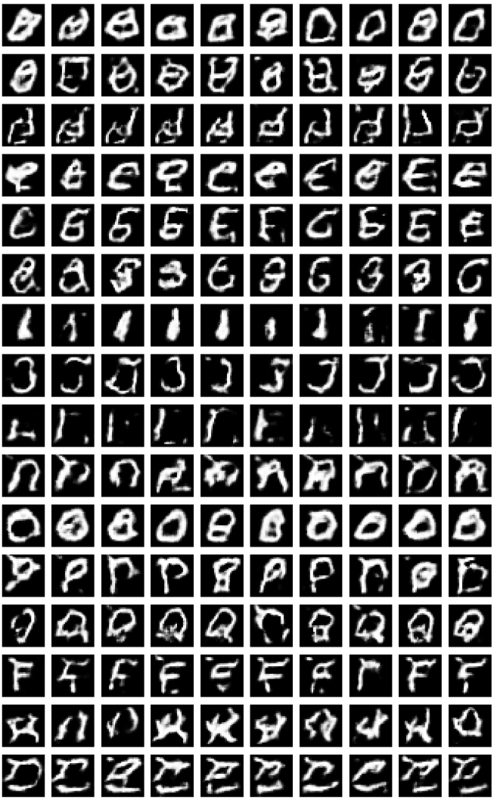
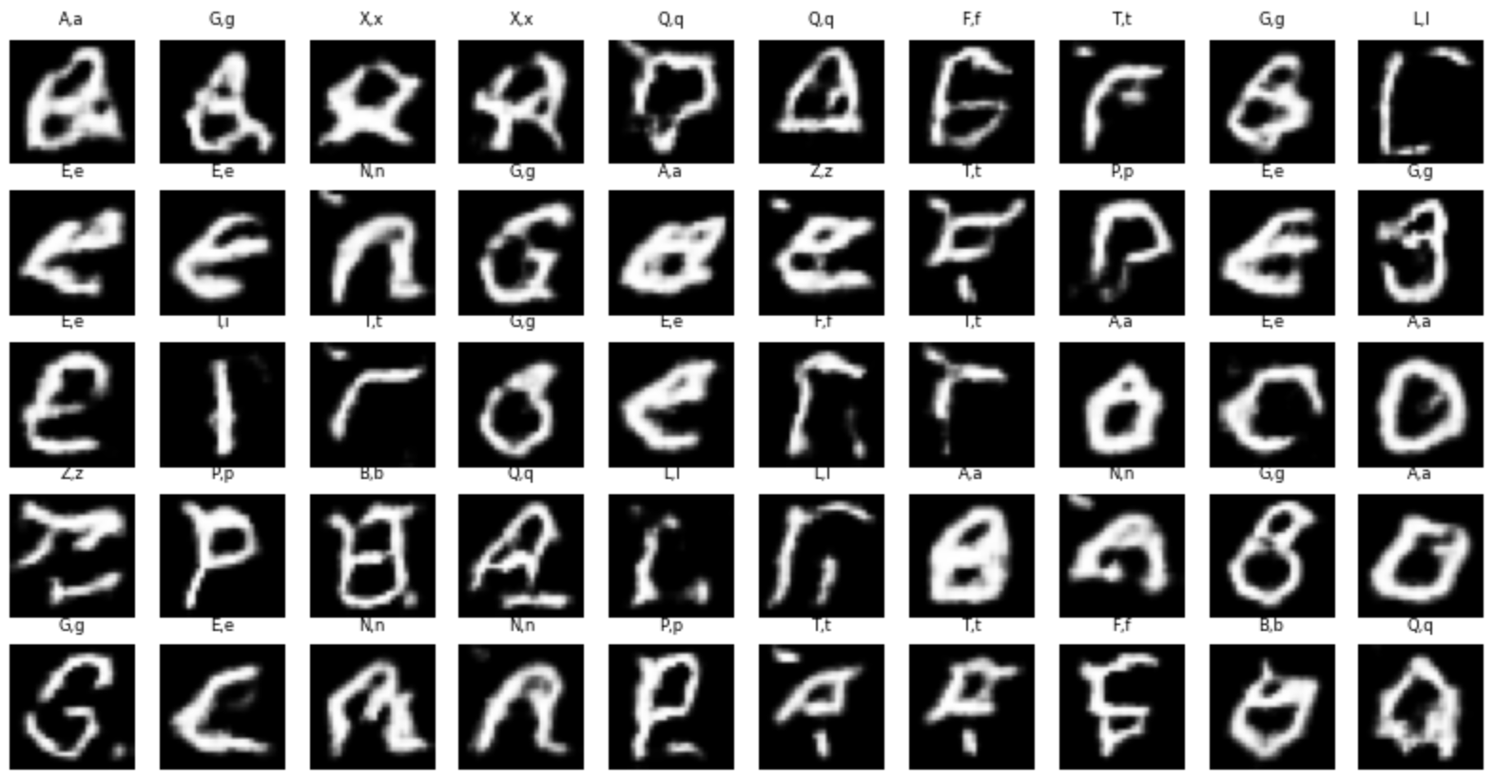
4) Building Model
2. cGAN
Generator: learns to generate fake images, but with a specific condition (e.g., generate the letter "A").
Discriminator: tries to distinguish between real and fake images while also considering the condition.
The key difference from DCGAN is that both the generator and discriminator receive extra information (e.g., class labels). This allows the model to generate images that belong to a specific class instead of random outputs.
This answers the question in the CA2 brief:
“If you are asked to generate images of a specific class, propose a way of doing it. (For example, you may consider a conditional GAN architecture.)”
160 images of cGAN:
(10 for each class)
50 images of cGAN:

Slide 11
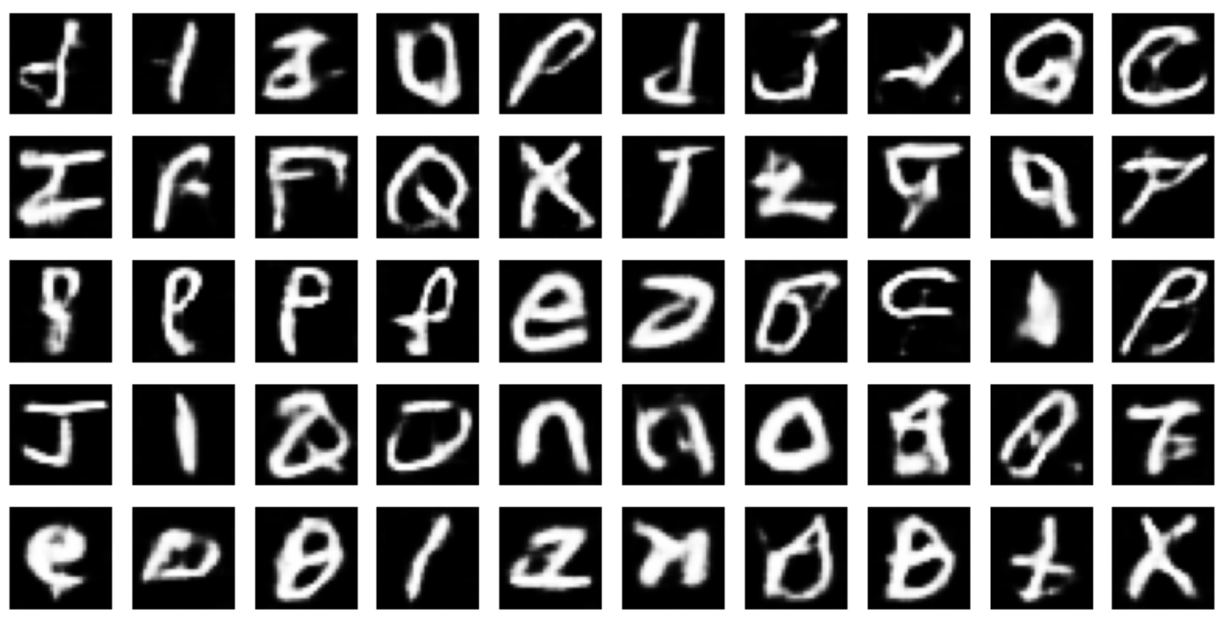
4) Building Model
3. WGAN
Instead of using the traditional binary cross-entropy loss, WGAN uses the Wasserstein distance (also known as Earth Mover’s distance) as a measure of difference between real and generated data distributions.
Generator: Learns to produce realistic images by minimizing the Wasserstein distance between generated and real data distributions.
Discriminator (called the “critic” in WGAN): Outputs a real-valued score instead of a probability, estimating how real or fake an input image is.
This approach addresses common GAN issues such as mode collapse and training instability, often resulting in more stable training and higher-quality generated images.
50 images of WGAN:

Slide 12
4) Building Model
Conclusion:
The best model after training for 10 epochs is: DCGAN
Human Evaluation Score:
DCGAN: 30/50 passable images generated
cGAN: 22/50 passable images generated
WGAN: 21/50 passable images generated
We decided to use further improve our DCGAN model.

Slide 13
5) Further Improvements
Overview:
Train longer (50-100 epochs)
Add dropout to the generator
Add label smoothing in the discriminator
Add Gaussian Noise to Discriminator Input
Try deeper generator: add more upsampling or a dense layer
Two-Time-Scale Update Rule (TTUR)

Slide 14
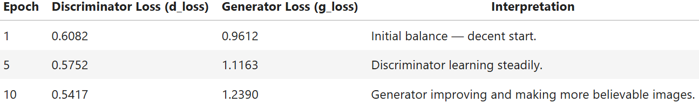
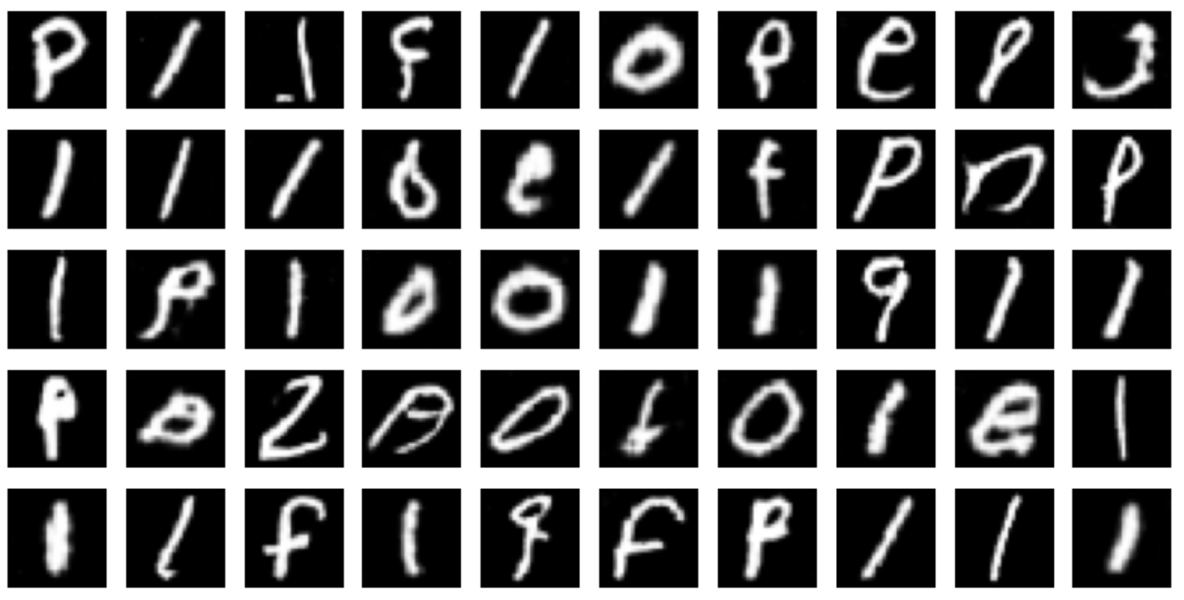
5) Further Improvements
1. Train longer
Our training logs during the baseline DCGAN:
50 images of longer trained DCGAN:
What this means:
The discriminator loss is decreasing slowly → it's learning to distinguish real/fake.
The generator loss is increasing → this is normal when the generator starts producing more realistic images that fool the discriminator.
No major signs of mode collapse or overfitting (yet).
This means to fully see the potential of DCGAN, we should train longer
Observations:
Score improved from 30 to 44 passable images
However, variety of images also decreased, many images of “l” generated.

Slide 15
5) Further Improvements
What does the increased number of “l”s mean?
That means our generator is getting stuck producing very similar outputs, likely because it's found a "safe" pattern that often fools the discriminator.
This is common in longer training runs when:
The discriminator becomes too strong, or
The generator gets lazy, exploiting an easy-to-fake shape (like "l").
Why is it happening?
The generator finds that generating "l"-shaped characters consistently fools the discriminator (especially early on).
Without enough diversity pressure, it keeps doing that, losing variety.
In the letters context, this means it ignores other characters and gets stuck.

Slide 16
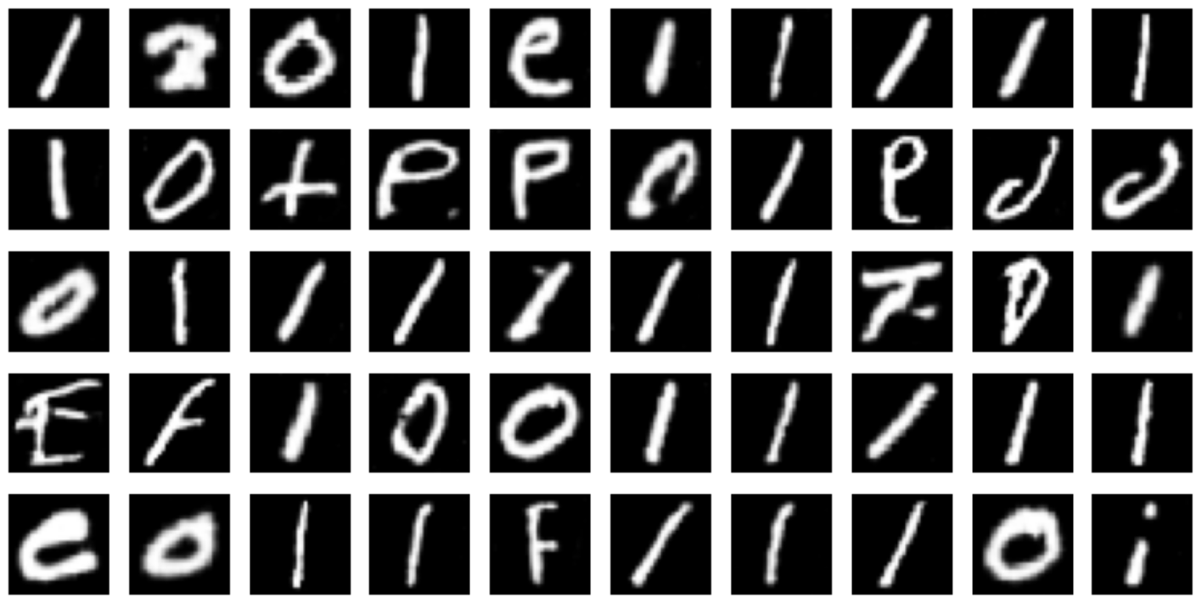
5) Further Improvements
2. Adding dropout in generator
What this does → this will help introduce randomness and reduce mode collapse by discouraging the generator from always producing the same shapes (like "l“).
50 images with dropout in generator:
Observations:
Number of “l” before: 20
Number of “l” after: 26
Number of passable images decreased from 44 to 41.

Slide 17
5) Further Improvements
Why is this happening?
1. g_loss got worse after adding dropout in generator
Dropout adds regularization but can slow down generator learning if applied too aggressively or in the wrong spots.
Our g_loss increasing (getting larger) means the generator is struggling a bit more to fool the discriminator.
Dropout can help generalization but might need tuning, try reducing the dropout rate or only adding dropout in certain layers.
2. More images of 'l' generated now (26 vs 20 before)
This could mean our generator is mode-collapsing on certain classes, favoring generating certain letters (like "l").
We can try techniques to reduce mode collapse like:
Adding noise to labels (label smoothing)

Slide 18
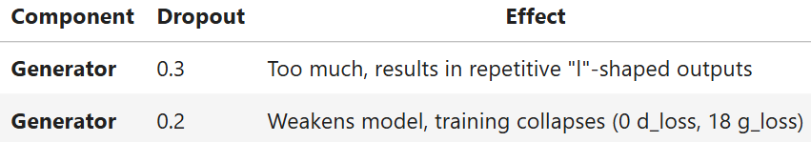
5) Further Improvements
Tried testing dropout 0.2 and started training, however:
Epoch 1/100 1706/1706 ━━━━━━━━━━━━━━━━━━━━ 22s 9ms/step - d_loss: -0.8033 - g_loss: 159.6640 Epoch 50/100 1706/1706 ━━━━━━━━━━━━━━━━━━━━ 11s 6ms/step - d_loss: 0.0276 - g_loss: 14.9222
These were the values that we got during training, we stopped the training after 50 epochs as the values of d_loss and g_loss were concerning and we wanted to test other values instead.
Summary of findings:

Slide 19
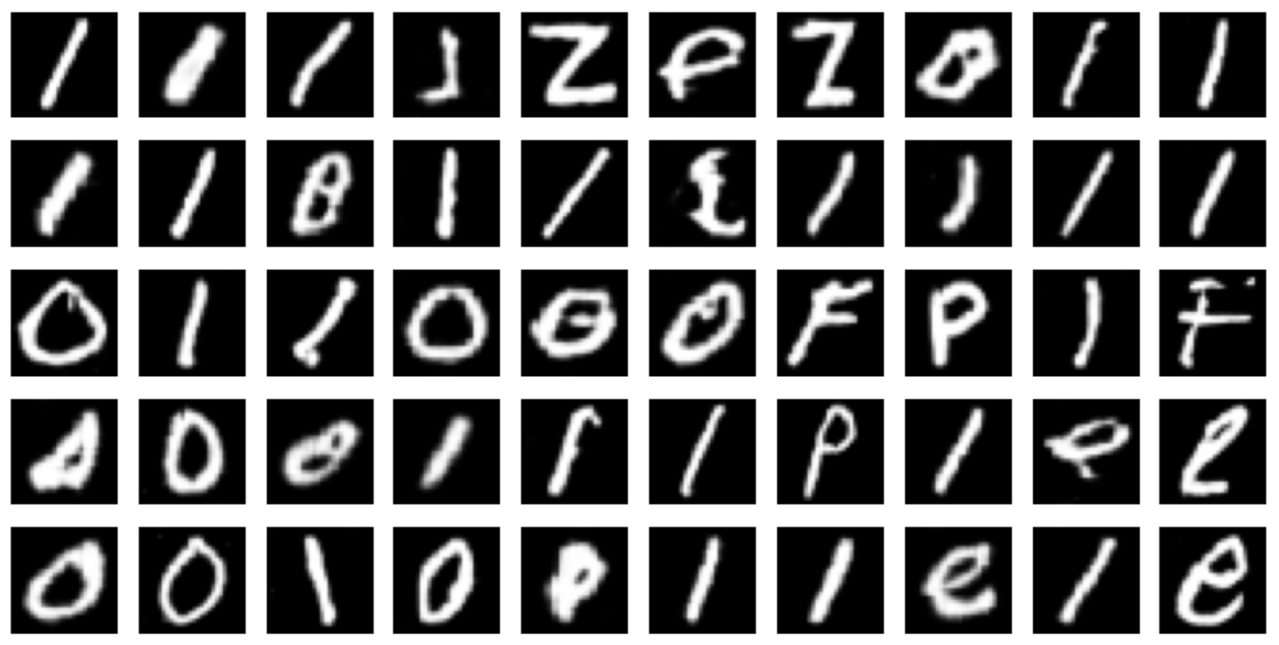
5) Further Improvements
What we tried next:
Keep discriminator dropout, don’t need change
Don’t dropout in generator → tried it and it did not help our results
Add Label Smoothing in the discriminator
Add Guassian noise to the discriminator inputs
3. Add Label Smoothing in the discriminator
Instead of labeling real images as 1.0, we label them as something like 0.9 or even sample from a range like 0.8 to 1.0. This discourages the discriminator from becoming overconfident, giving the generator a chance to catch up.
50 images of label smoothing in discriminator:
Observations:
Number of “l” before: 20
Number of “l” after: 22
Number of passable images decreased from 44 to 42.

Slide 20
5) Further Improvements
Why did Label Smoothing not help biasness?
Label smoothing is mainly designed to:
Prevent the discriminator from becoming too confident in its classifications.
Encourage the generator to receive useful gradients longer into training.
However, label smoothing does not force the generator to explore more modes or generate more diverse outputs. It only softens the discriminator's confidence. When the generator finds a shape (like "l") that successfully fools the discriminator, it has no reason to stop generating it, regardless of label smoothing.
In fact, label smoothing can unintentionally:
Make the discriminator less able to penalize repetitive samples like "l"
Result in weaker feedback to push the generator toward other modes (e.g., different letters)

Slide 21
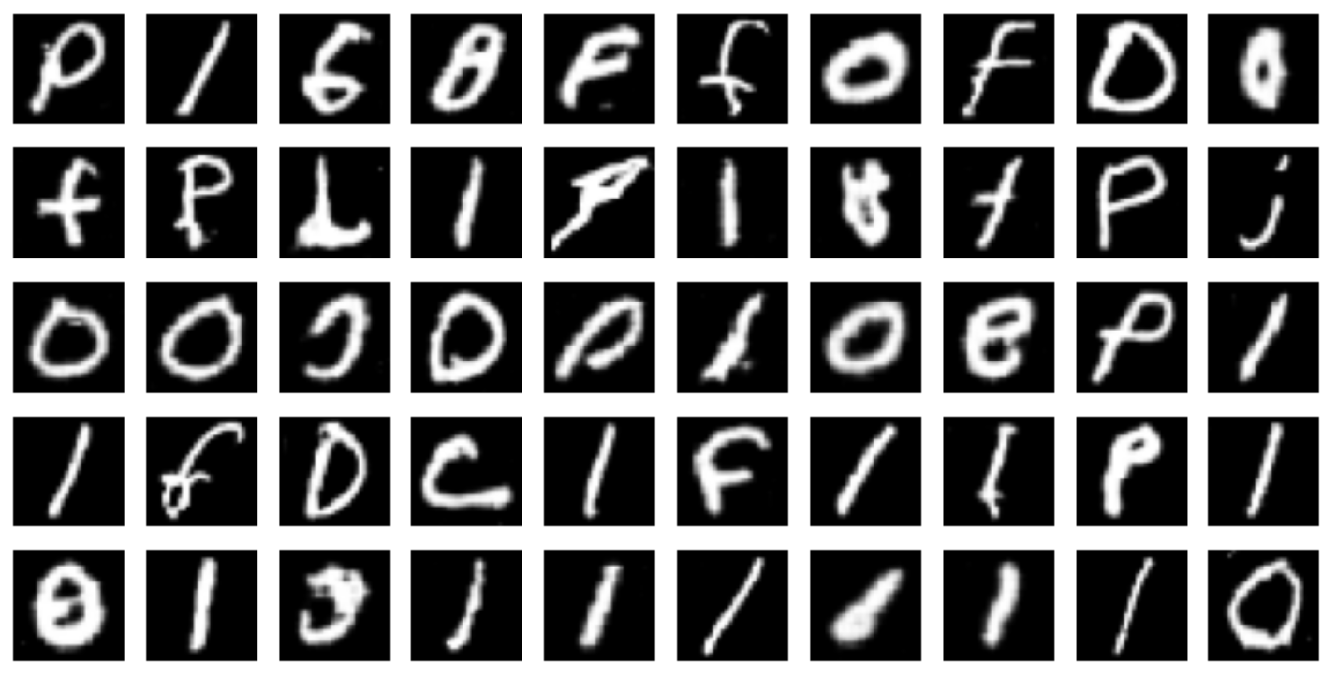
5) Further Improvements
4. Add Guassian noise to discriminator input
Injecting Gaussian noise into the discriminator’s input can make it less confident and force it to focus on more meaningful features rather than memorizing fine details.
50 images of Guassian noise in discriminator input:
Observations:
Number of “l” before: 20
Number of “l” after: 14
Number of passable images decreased from 44 to 38.
While adding Guassian noise to discriminator input reduced biasness, it also lowered overall image quality.

Slide 22
5) Further Improvements
Why did Guassian noise make DCGAN generate lower quality images?
1. Discriminator Becomes Less Accurate
Gaussian noise is meant to regularize the discriminator by preventing it from overfitting. But early in training, it can make the discriminator too weak, giving the generator poor feedback, which leads to lower-quality images.
2. Slower or Unstable Learning
The noise adds randomness to real and fake inputs, which can cause the model to take longer to converge or generate inconsistent outputs, especially if the noise level is too high or training time is short.
Conclusion:
Gaussian noise improved diversity (fewer repeated letters) but weakened image clarity and sharpness, causing more outputs to be judged as nonsense. To improve results, we could fine-tune the noise level or apply it selectively during early epochs only.

Slide 23
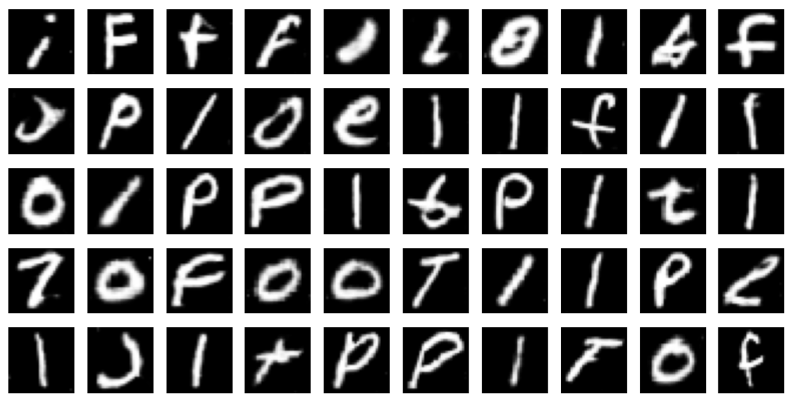
5) Further Improvements
Options to try
Option 1: Fine-tune the Noise Level What it means: Lower the standard deviation of the Gaussian noise (e.g., from 0.1 to 0.05).
Option 2: Apply Noise Only During Early Epochs What it means: Add Gaussian noise in the discriminator only for the first N epochs (e.g., first 20 out of 100).
We decided to try option 2.
50 images with noise only during early epochs:
Observations:
Number of “l” before: 20
Number of “l” after: 14
Number of “l” after option 2: 14
Number of passable images decreased from 38 to 36.
This suggests that early-only noise injection disrupted the learning dynamics without offering sustained benefits.
We decided to stick with Guassian noise but add it throughout the training.

Slide 24
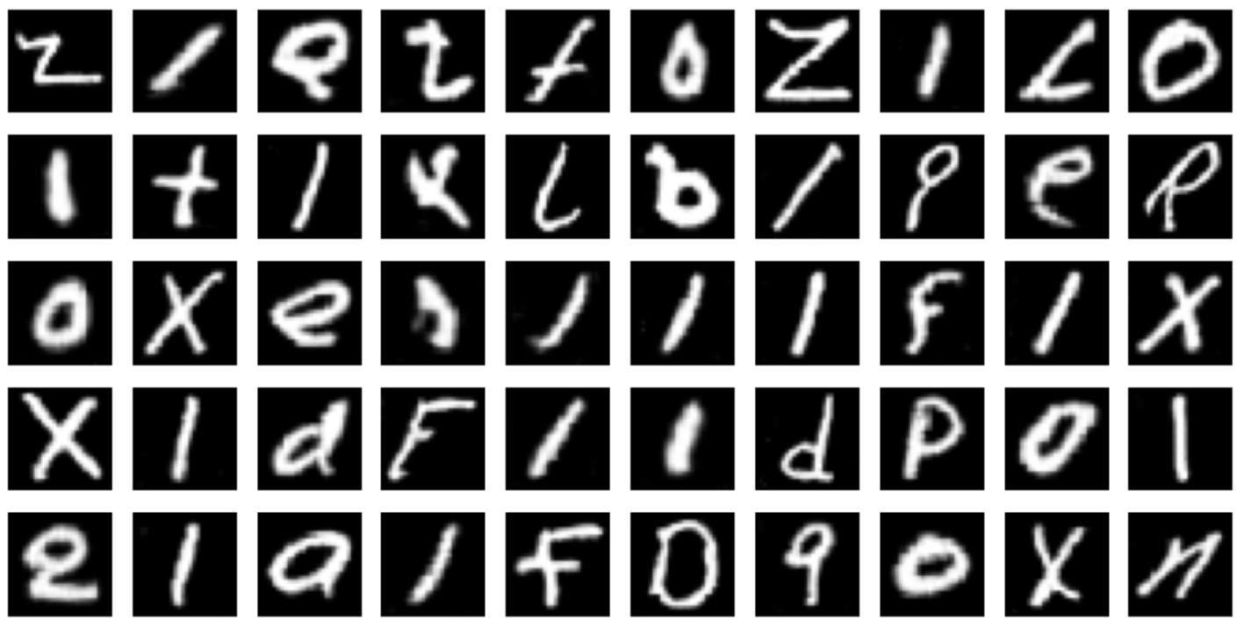
5) Further Improvements
5. Try deeper generator
Updated Generator:
Feature channels: 128 → 256 at the beginning
Number of conv layers from 3 → 5
Good for increasing expressiveness while still suitable for 28x28 images
50 images of deeper generator:
Observations:
Passable images before: 38
Passable images after: 45
The deeper generator had more layers and parameters, giving it greater capacity to learn complex patterns in the data.
Next, we will try hyperparameter tuning.

Slide 25
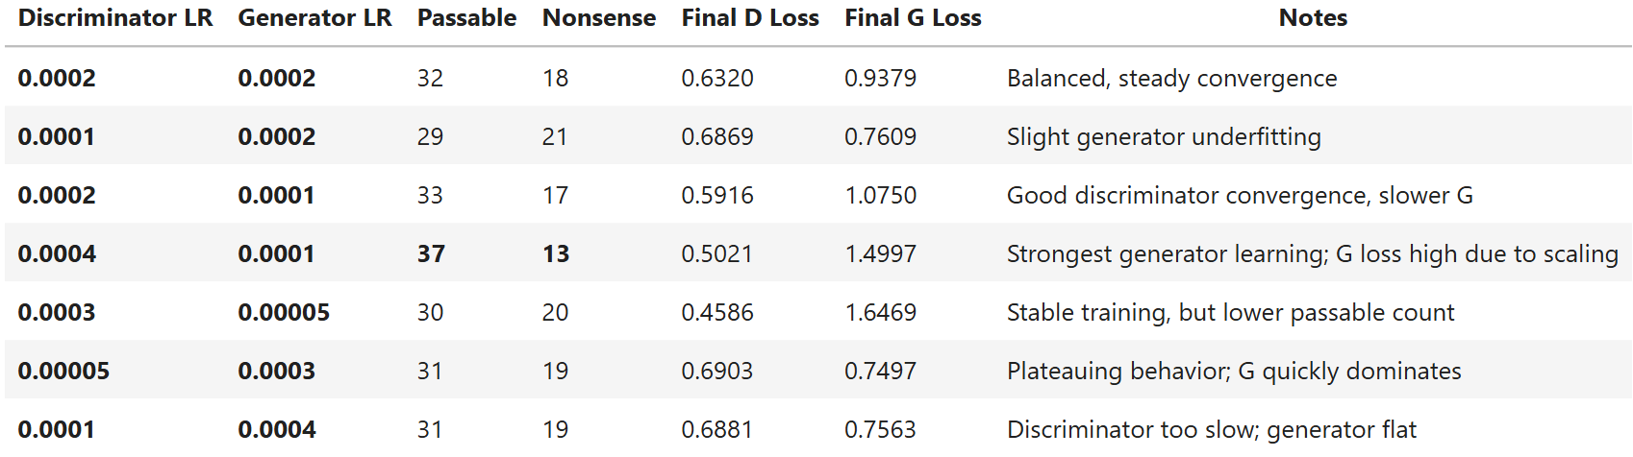
5) Further Improvements
6. Two-Time-Scale Update Rule (TTUR) → hyperparameter tuning
Trying out these learning rates:
Discriminator learning rate, generator learning rate
ttur_configs = [(0.0002, 0.0002), (0.0004, 0.0001), (0.0001, 0.0004), (0.0002, 0.0001), (0.0001, 0.0002), (0.0003, 0.00005), (0.00005, 0.0003)]
Summary:
Observations:
Best: Discriminator LR = 0.0004, Generator LR = 0.0001
Highest passable output (37/50)
Stable and improving loss curves:
d_loss decreased from 0.46 → 0.50 range
g_loss increased smoothly to 1.5, which is not a bad sign – it often reflects that the generator is producing stronger signals that the discriminator finds harder to reject

Slide 26
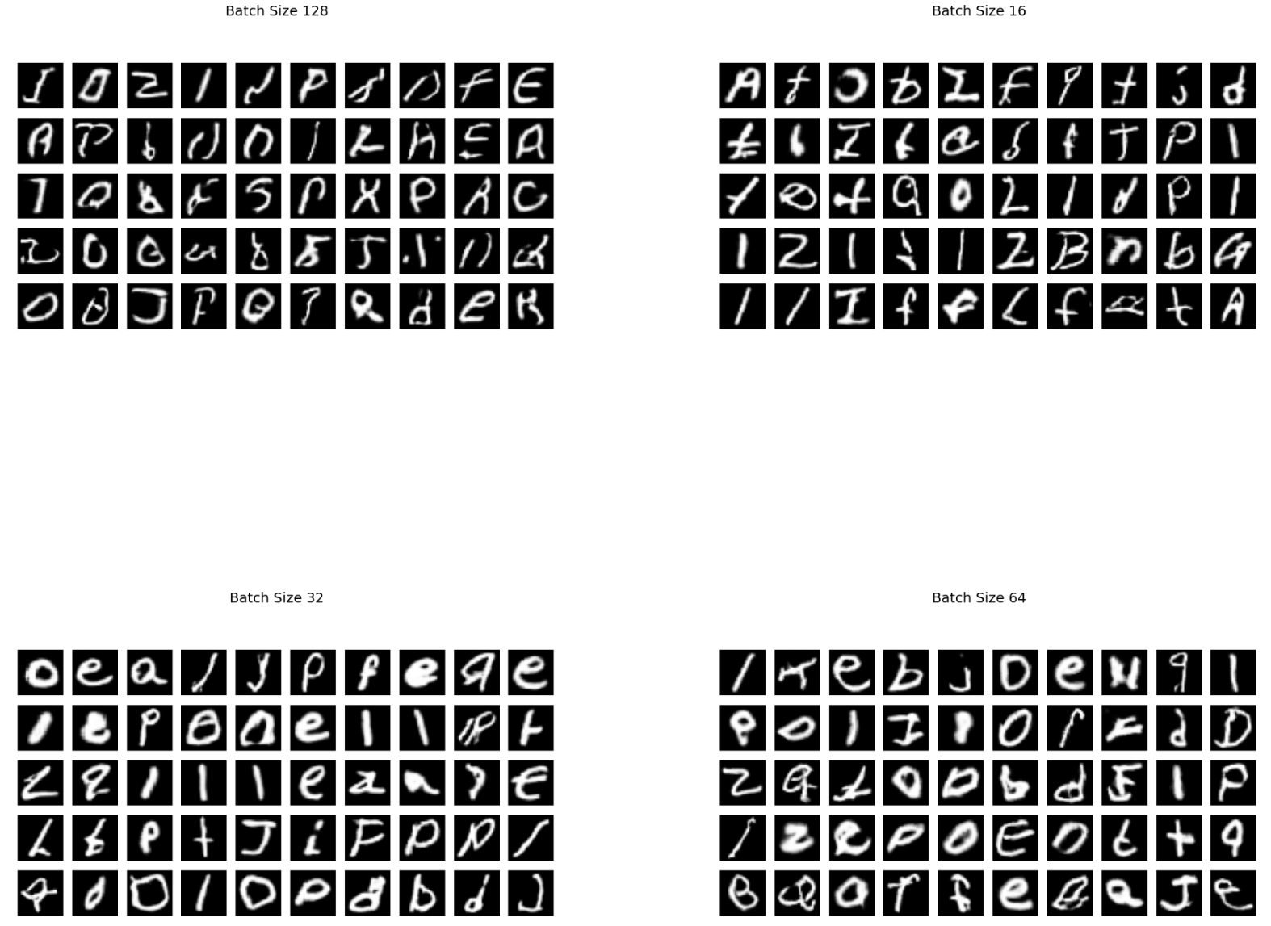
5) Further Improvements
7. Tune Batch Size
Observations:
Batch Size (16):
- Passable: 32/50
- Nonsense: 18/50
Batch Size (32):
- Passable: 33/50
- Nonsense: 17/50
Batch Size (64):
- Passable: 32/50
- Nonsense: 18/50
Batch Size (128):
- Passable: 19/50
- Nonsense: 31/50
Best Batch Size: 32
Why did 128 perform the worst?
Fewer Learning Steps
Bigger batch = fewer updates per epoch.
The generator doesn't get enough chances to improve.
At just 20 epochs, this really slows down learning.

Slide 27
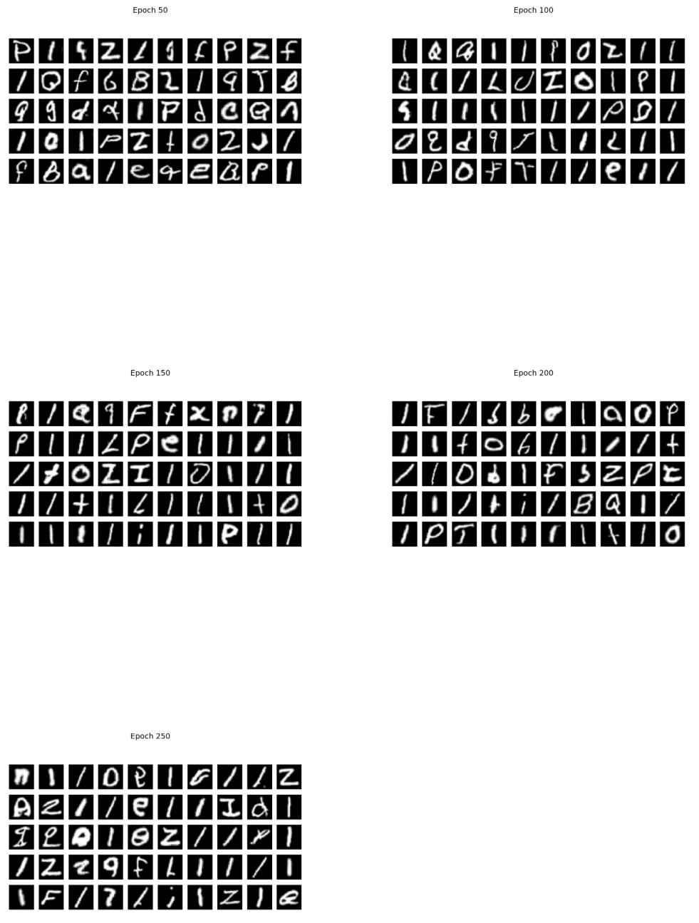
5) Further Improvements
Observations:
Epochs (50):
- Passable: 38/50
- Nonsense: 12/50
Epochs (100):
- Passable: 42/50
- Nonsense: 8/50
Epochs (150):
- Passable: 44/50
- Nonsense: 6/50
Epochs (200):
- Passable: 40/50
- Nonsense: 10/50
Epochs (250):
- Passable: 40/50
- Nonsense: 10/60
8. Tune Epochs
epochs_list = [50, 100, 150, 200, 250]
Best Epochs: 50
While 150 epochs gave the highest passable rate (44/50), it also exhibited the most bias toward a single letter (26 "l" generated), which reduces usefulness for a balanced multi-class generator. Epoch 50 offers the best trade-off between quality and variety, with fewer biased outputs and reasonably high passable quality.

Slide 28
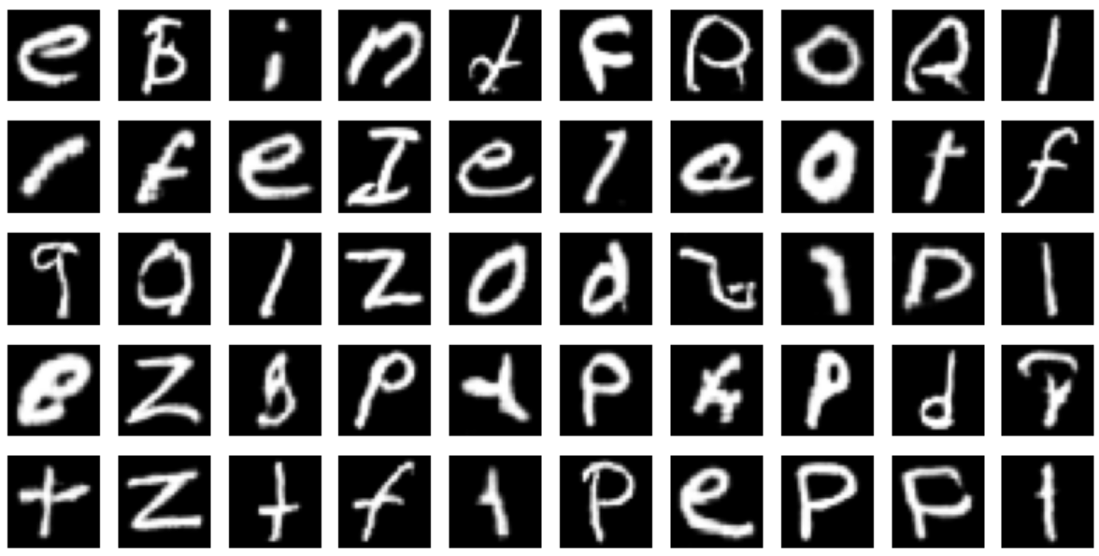
Best Model
After hyperparameter tuning, we found that:
Best Batch Size: 32
Best Learning Rates: Discriminator LR = 0.0004, Generator LR = 0.0001
Best Epochs: 50
50 images of our best model:
Observations:
Passable images: 36/50

Slide 29
Conclusion
What class(es) is/are relatively easier/harder to generate? Why?
Easier classes:
Letters with distinct, simple shapes and minimal variation in handwriting, e.g. L, O
The generator can learn them quickly because they have low intra-class variability and clear contrast from other classes.
Harder classes:
Visually similar letters: e.g. I vs J, E vs F.
These are harder because small stroke variations become significant to human perception but are subtle for the GAN to capture.
There’s also a risk of mode collapse, where the generator produces shapes blending features from multiple similar letters.
2. Capital vs. lowercase pairs with very different shapes: e.g. a vs A, g vs G.
Even though they share the same semantic meaning, their structures are almost entirely different in handwriting.
The model must essentially learn two distinct visual concepts for the same class label, which doubles the complexity for that class.
This increases intra-class variability and can make it harder for the generator to converge on a clean representation.

Slide 30
Conclusion
If you are asked to generate coloured images instead of black-and-white ones, do you think it would be easier or harder to produce better quality results?
Producing high-quality results would likely be harder because:
The generator must learn not only shape but also colour distributions and variations.
Colour adds another dimension of variability, increasing the complexity of the mapping from latent space to output.

Slide 31
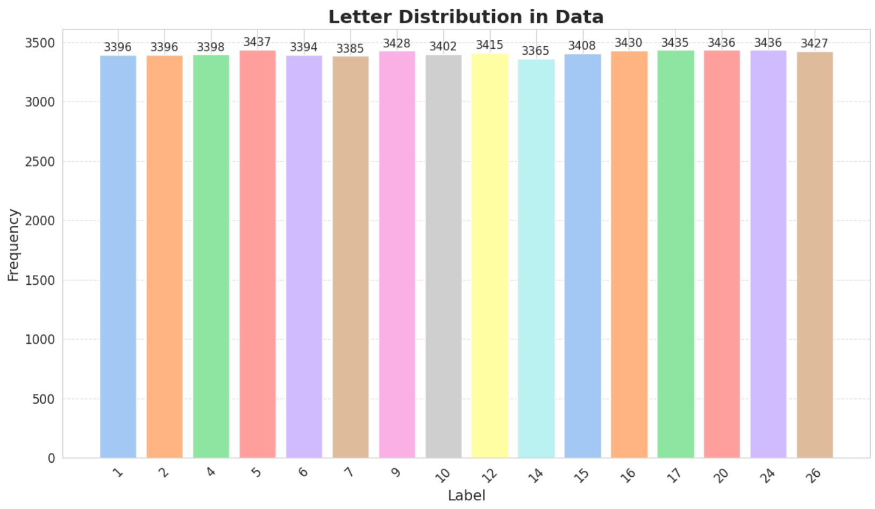
Data Augmentation?
After examining class distribution:
We decided that data is already evenly distributed across all classes. As shown in the bar chart, the frequency of each label is very similar, ranging from 3,365 (lowest) to 3,437 (highest) samples per class.
This indicates that there is no significant class imbalance that would negatively impact model performance or introduce bias during training.
We did not do data augmentation.

Slide 32
Other Things We Tried
1. Use Spectral Normalization in Discriminator → (Helps control discriminator strength and prevents it from overpowering the generator.)
However, when trying to install the add-on, it was not compatible with our current version of TensorFlow or Python (2.19 & 3.12)
Why did we not use Fréchet Inception Distance (FID) or Inception Score (IS)?
Fréchet Inception Distance (FID):
FID compares real vs. generated image distributions using an embedding model like InceptionV3. However, FID assumes 3-channel RGB images and real labels.
We are using black & white images that only has 1-channel, thus this method is unsuitable for us.
Inception Score (IS):
Evaluates whether generated images look like something "classifiable"
Whether the generated images are diverseBut again, this assumes an ImageNet-trained classifier, which isn’t ideal for handwritten letters unless adapted.

Slide 33
Another Option For:
"If you are asked to generate images of a specific class, propose a way of doing it. (For example, you may consider a conditional GAN architecture.)“
Alternate Option: Train Separate DCGANs for Each Class
we didn’t pick the brute-force DCGAN method because it's inefficient, repetitive, and hard to scale, especially when dealing with many classes. Conditional GANs solve this by incorporating class labels directly into the model, offering flexibility, control, and better performance with less overhead.

